Slide 1
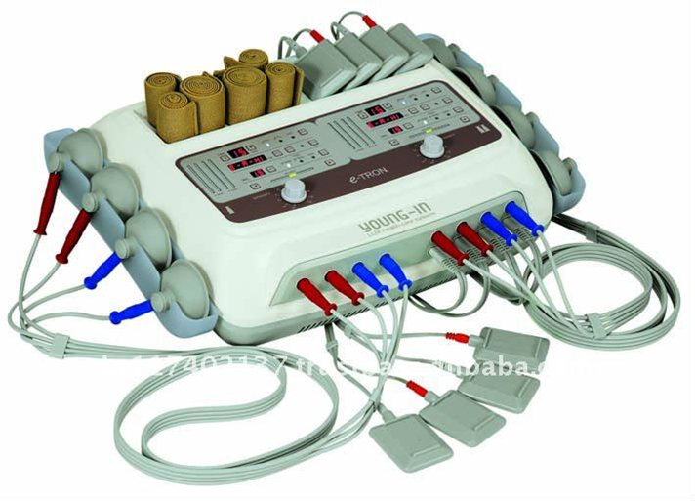
Electro-muscular stimulator
principles of operation
function
use
scientific principles
construction
components
system diagram
inputs/outputs
troubleshooting
identifying common faults
replacing components
rectifying faults
18.4.4 Maintain an electro-muscular stimulator
Unit C18.4 Maintaining Physiotherapy Equipment
Module 279 19 C Medical Instrumentation II
©
dr. Chris R. Mol, BME, NORTEC, 2015

Slide 2
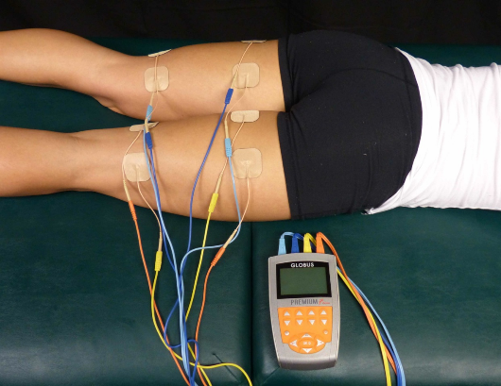
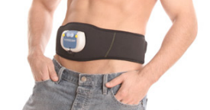
Principles of operation
Electrical muscle stimulation (EMS) generates muscle contractions using electric impulses. The device generates electrical impulses which are delivered through electrodes on the skin close to the muscles to be stimulated. The impulses mimic the nerve signals which normally come from the central nervous system, causing the muscles to contract. Muscle contraction helps to strengthen the affected muscle, just like exercise would.
Applications are:
a strength training tool for healthy subjects and athletes
a rehabilitation tool for immobilized with musculoskeletal injuries, such as damage to bones, joints, muscles, ligaments and tendons
a testing tool for evaluating the neural and/or muscular function.
Consumer devices exist in which EMS circuitry is contained in belt-like garments, so-called ab toning belts. Many sources say that this does not work well……
©
Electro-muscular stimulator
dr. Chris R. Mol, BME, NORTEC, 2015

Slide 3
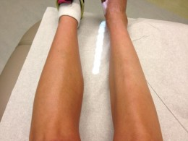
Principles of operation
Applications in rehabilitation:
• Relaxation of (involuntary) muscle spasms
• Prevention of disuse atrophy (muscle wastes away when not used)
• Increasing local blood circulation
• Muscle build-up
EMS is commonly used for people who have had a stroke or an orthopedic surgery. Often, these patients have trouble trying to move a muscle or joint. With EMS, the muscle can contract without the help of the patient. Doing this while having the subject actively try to contract the muscle can sometimes get the brain to re-learn how to contract the muscle on its own.
muscle atrophy in right leg
EMS is not to be used for:
wearers of pacemakers
use on vital parts, such as carotid sinus nerves, across the chest, or across the brain
Caution is required for use during pregnancy, menstruation, and other conditions that may be affected by muscle contractions.
Potential adverse effects include skin irritations and burns.
©
Electro-muscular stimulator
dr. Chris R. Mol, BME, NORTEC, 2015

Slide 4
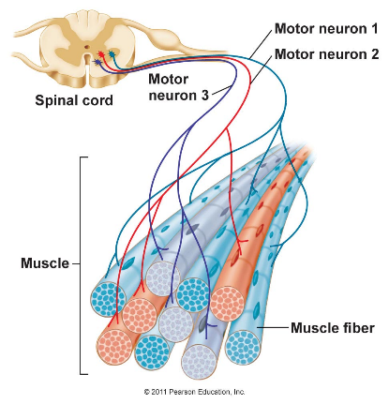
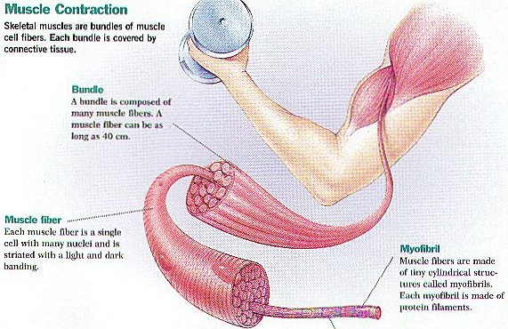
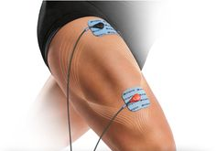
Physiological Principles
Nerves/neurons can activate muscle fibers through an electrical impulse.
Activation can also be accomplished through the skin, with an electrical stimulus
Muscles consist of muscle bundels,
which consist of muscle fibers
©
Electro-muscular stimulator
dr. Chris R. Mol, BME, NORTEC, 2015

Slide 5
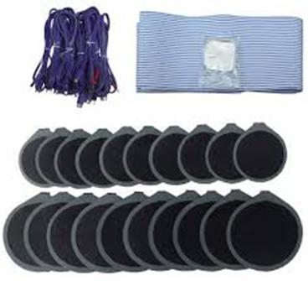
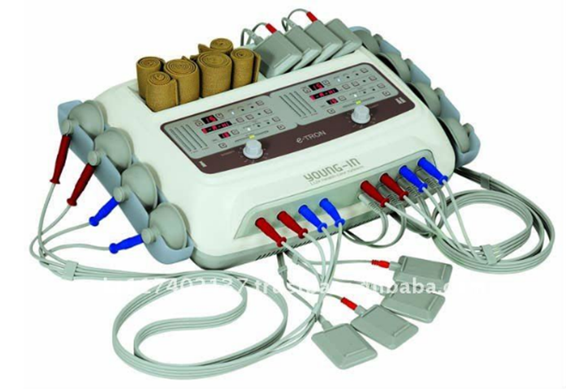
Components
EMS electrodes are generally pads that adhere to the skin
most units are battery powered to reduce electrical current (overdose) risks
©
Electro-muscular stimulator
dr. Chris R. Mol, BME, NORTEC, 2015

Slide 6
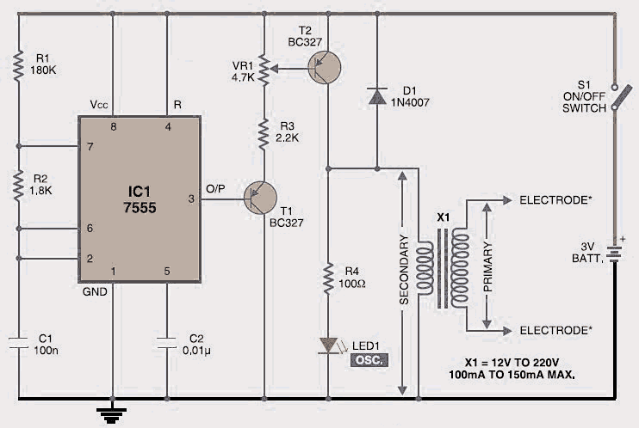
System Diagram
The figure shows the circuit of a simple muscle stimulator. IC 7555 is wired as an astable multivibrator to generate about 80Hz pulses.
Using potentiometer VR1 you can control the intensity of current sensing at the electrodes. The brightness level of LED1 indicates the amplitude of the pulses. If you want to increase the intensity level, replace the 1.8kΩ resistor with 5.6kΩ or higher value up to 10kΩ.
X1 is a small mains transformer with 220V primary to 12V, 100/150mA secondary. It must be reverse connected, i.e., connect the secondary winding to the collector of T2 and ground, and primary winding to the output electrodes. The output voltage is about 60V but the output current is so small (0-80 mA into 500 Ohm load) that there is no threat of electric shock.
©
Electro-muscular stimulator
dr. Chris R. Mol, BME, NORTEC, 2015

Slide 7
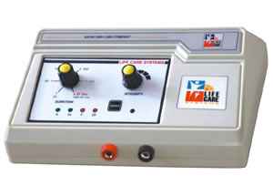
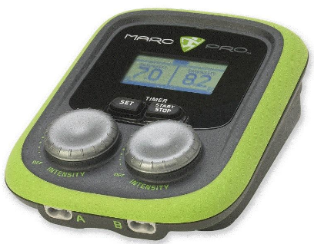
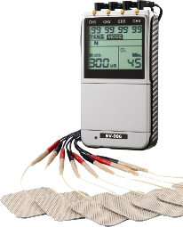
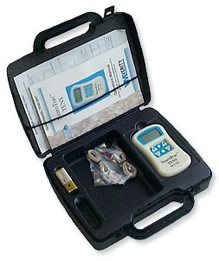
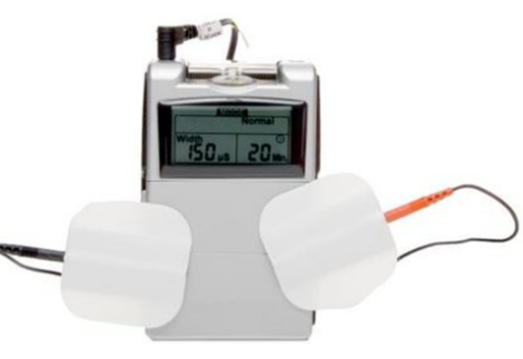
Configurations and Parameter Selection
Most EMS devices allow limited settings only (few knobs and buttons).
Usually pulse width and pulse amplitude, sometimes combined as the ‘intensity’ plus a timer for treatment duration.
The more complex looking systems often provide also non-EMS functions, like ultrasound or TENS in the same device.
©
Electro-muscular stimulator
dr. Chris R. Mol, BME, NORTEC, 2015

Slide 8
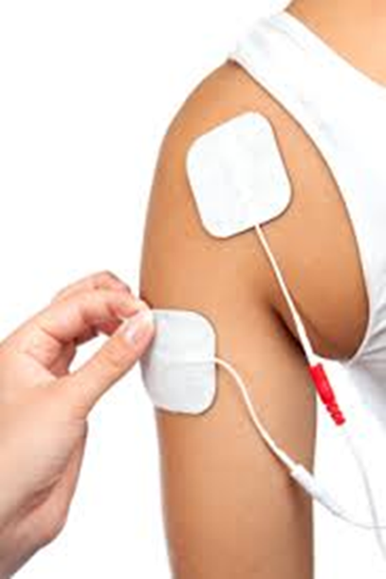
Maintenance
Preventive Maintenance:
keep clean
exchange of batteries
careful with electrodes & wires
Corrective Maintenance:
user error in electrode attachment
user error: treatment time has expired (switch off and on)
power problems with (rechargeable) batteries
broken wires/leads
… replacement of unit
©
Electro-muscular stimulator
dr. Chris R. Mol, BME, NORTEC, 2015

Slide 9
Safety Considerations
Electrical Muscle Stimulation (EMS) is relatively safe for any individual who has the capability to do normal exercise.
In some individuals, certain risks are there with the use of EMS such as irritation of the skin beneath the adhesive pads and temporary pain from the electrical charge.
If the pads are placed over the heart or over pacemaker leads, it may lead to cardiac arrhythmia. If placed over the throat, it could cause low blood pressure. When placed over a pregnant uterus, it may cause damage to the fetus.
Due to these risks, electrical stimulation should be avoided over these regions.
©
Electro-muscular stimulator
dr. Chris R. Mol, BME, NORTEC, 2015

Slide 10
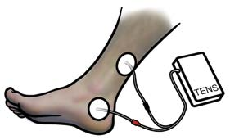
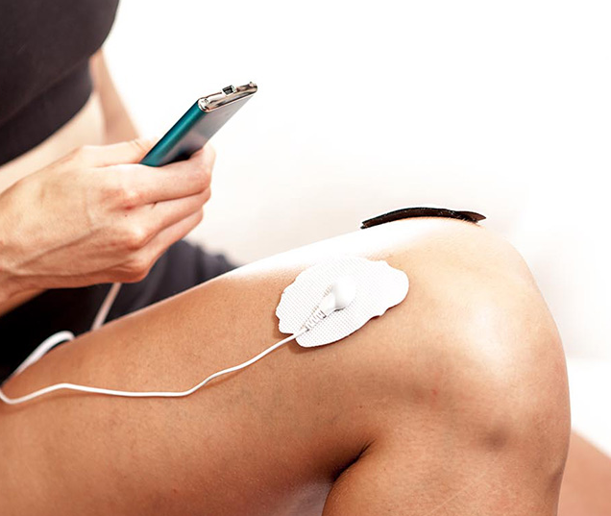
Transcutaneous Electrical Nerve Stimulation (TENS)
A Trans-cutaneous (through the skin) ENS system aims at relieving chronic pain, often from joints and back.
A TENS device is usually a small, battery-operated unit that delivers an electric current to the affected area via two electrodes.
The electric current activates the neurons and blocks transmission of pain signals from the affected body part to reach your brain (where such signals are translated into a feeling of pain).
A TENS device does not lead to muscle contraction, and is therefore not a EMS system. However, both technology and patient target group of TENS and EMS are much related, so TENS capability is often built into an EMS unit.
There's not enough firm evidence to say for sure whether TENS is a reliable method of pain relief.
With some patients it is effective, for others, it is not.
©
Electro-muscular stimulator
dr. Chris R. Mol, BME, NORTEC, 2015

Slide 11
END
The creation of this presentation was supported by a grant from THET:
see https://www.thet.org/

